Slide 1
eCar-Rental
SWE-project:
Biniam Arefaine: id: 110972
Essey tezare: id: 986469
Dawit hailu: id: 110974
https://github.com/etezare/Car-Rental

Slide 2
Title and Content Layout
Vision Document
Introduction
Problem Statement
Software Requirements Specification
Use Case Model
System Architecture Analysis
System Architecture Analysis Diagram
Key Abstractions
Use Case Designs
Sequence Diagram
E-R Diagram
Class Diagram

Slide 3
1. Vision Document
Contents
Introduction
Problem Statement

Slide 4
Introduction
Renting a car is a convenient option for anyone who needs a temporary vehicle for a vacation, special event, business outing or during a period when you’re in between cars. Although the process of renting a car might vary from one location or company to the next, a few standard rules apply.
Renting a car is usually as easy as contacting a rental car company and answering a few questions about your needs and your budget. The first factor the company is going to consider is when you need the car, and for how long. It will then research what it has available during that time period. Based on your budget, you’ll then be able to select which car you’d like.
Most rental agencies will let you do all of this online, which means you can just pick up the car on the day you need it. You can usually return your rental vehicle at any franchise of the same company, which means you can drop it off at your arrival destination if that is more convenient for you.
When you go to pick up your car, be ready to show proof of address, your driver's license, insurance policy, a valid telephone number and/or email address, and a valid credit or debit card. Most rental agencies will not accept cash as a form of payment because they use your credit or debit card to bill you for any liabilities you face in the event that you damage the vehicle.
Also, be sure to check your rental agreement to see how many miles you are allowed to travel in your rental car without facing an additional fee. If you go over your mileage restrictions, you may be forced to pay for a higher mileage limit, or you may even be charged for each additional mileage you use. You could also be charged for going out of state, so be sure to check with your rental agency before leaving town.

Slide 5
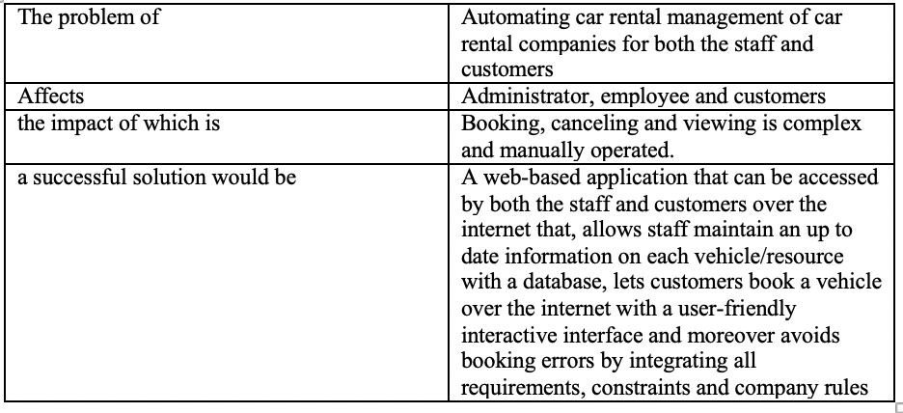
Problem Statement

Slide 6
2. Software Requirements Specification
Content
Use Case Model
Use Case Diagram

Slide 7
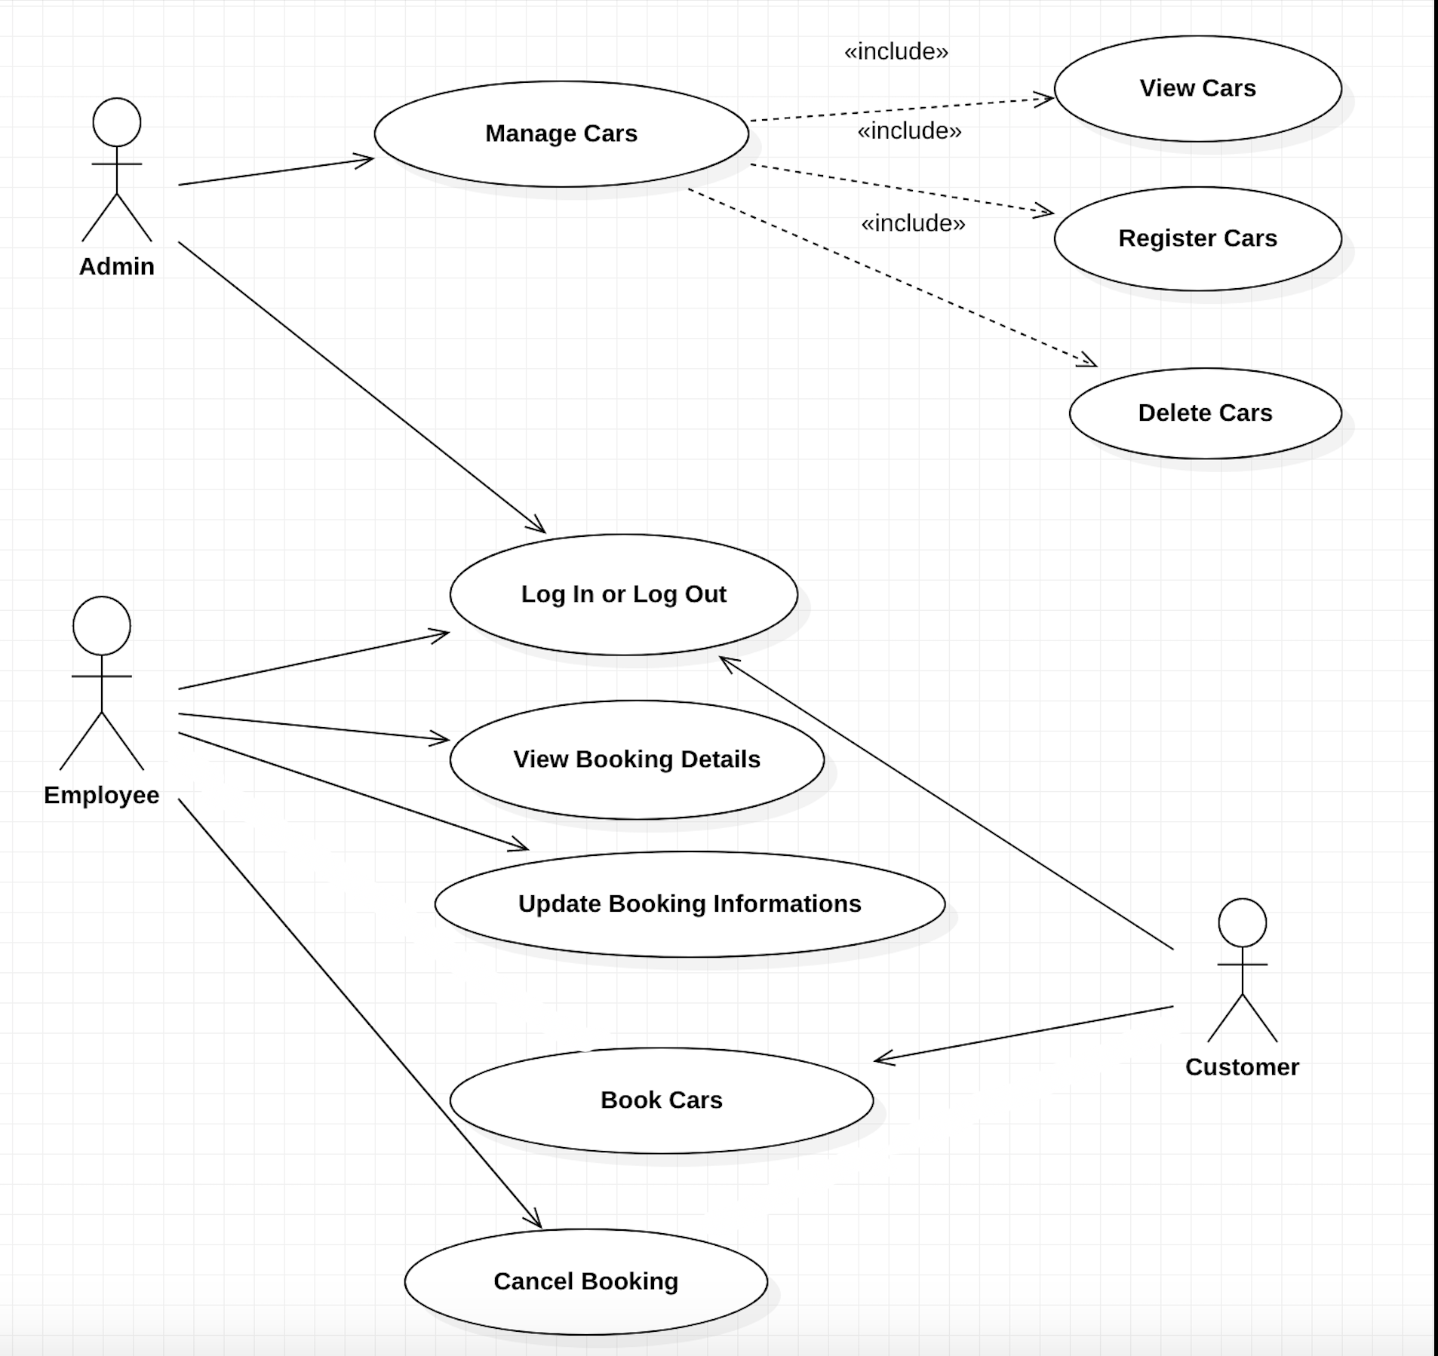
Use Case Diagram

Slide 8
3. System Architecture Analysis
Content
System Architecture Analysis Diagram
Key Abstractions

Slide 9
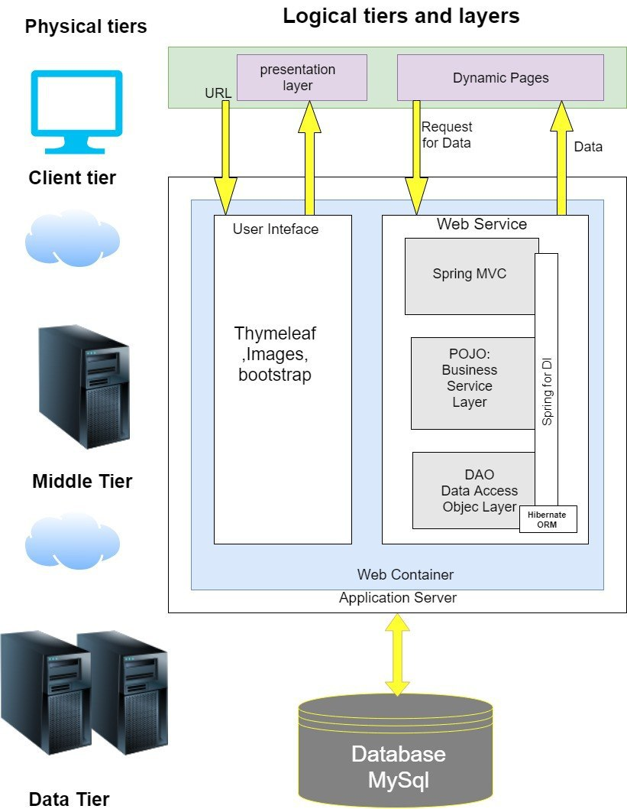
System Architecture Analysis Diagram

Slide 10
Key Abstractions
Vehicle
Staff
Customer
Booking
Address
Payment
Category
Credential
Role
Address

Slide 11
4. Use Case Designs
Content
Sequence Diagram
Register a Car : Use Case Sequence Diagram
Booking a Car: Use Case Sequence Diagram

Slide 12
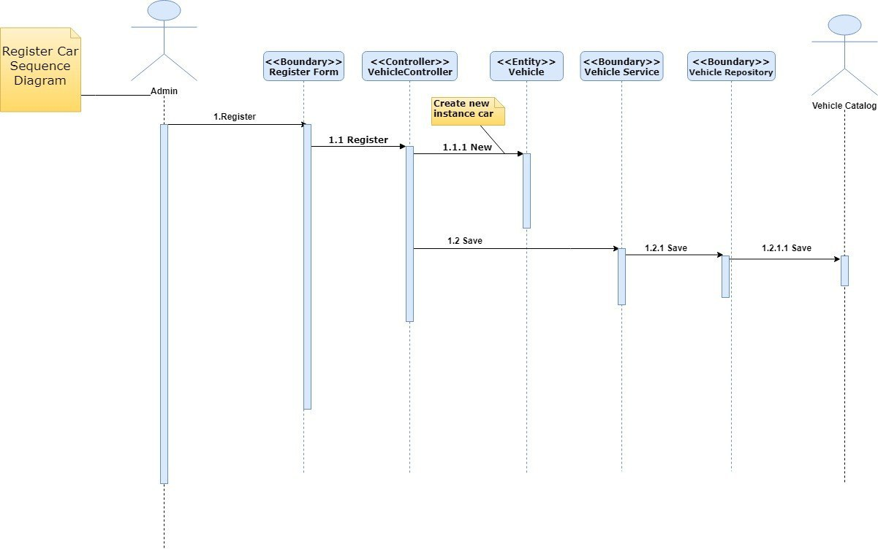
Register a Car: Use Case Sequence Diagram

Slide 13
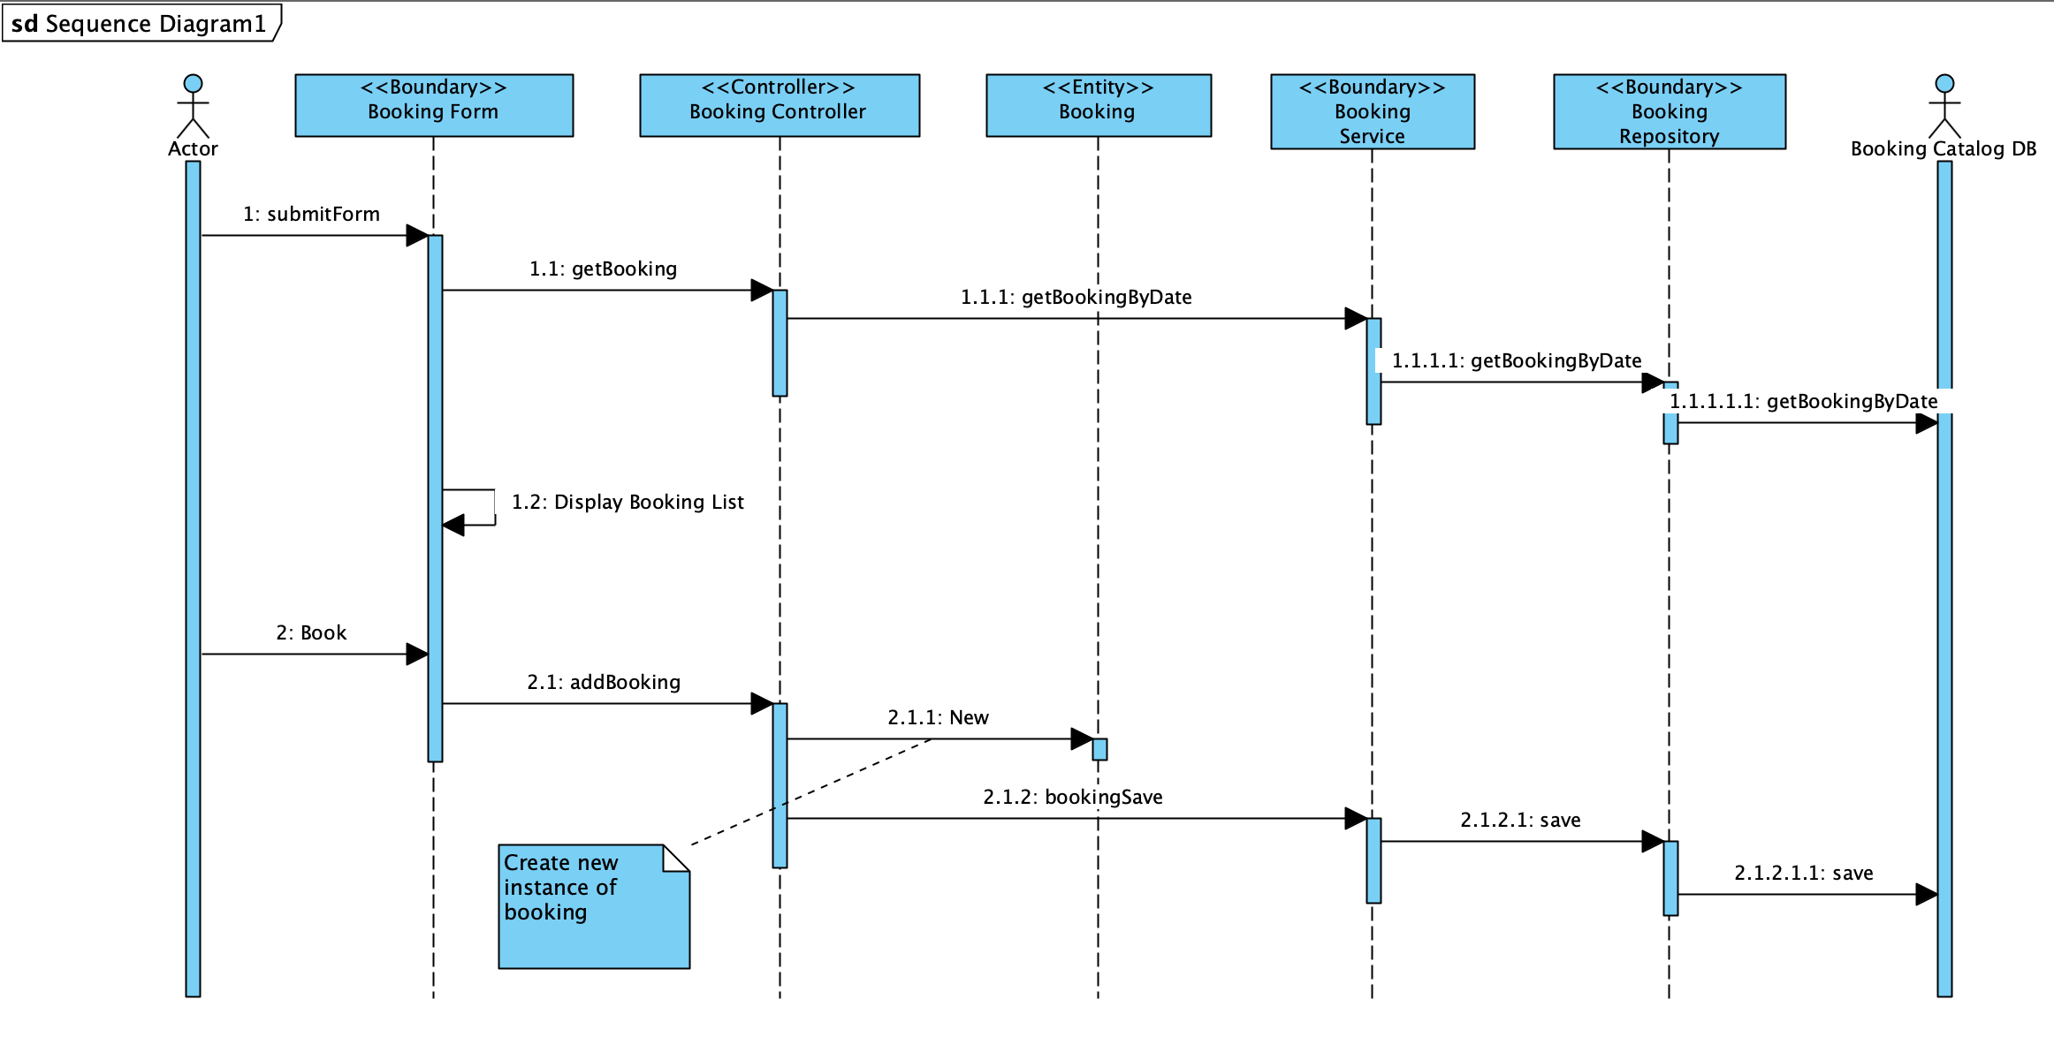
Booking a Car: Use Case Sequence Diagram

Slide 14
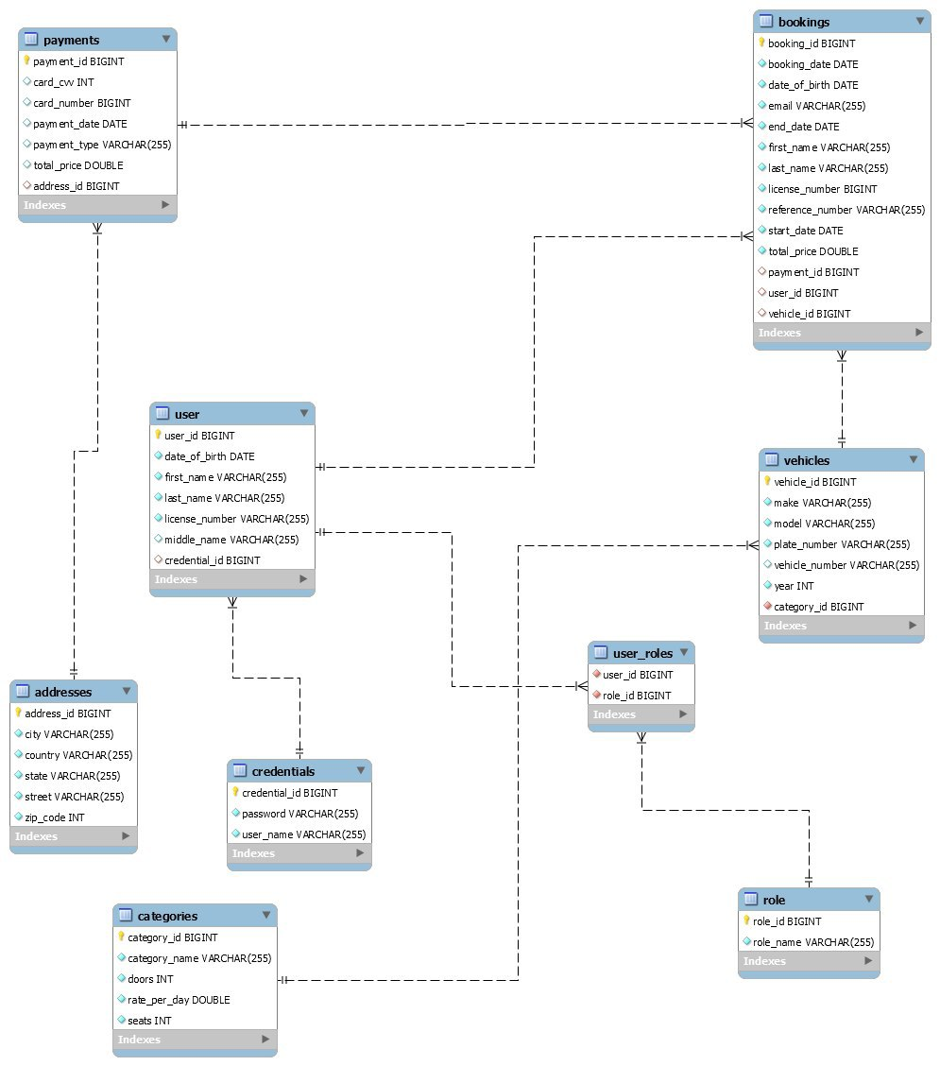
E-R Diagram

Slide 15
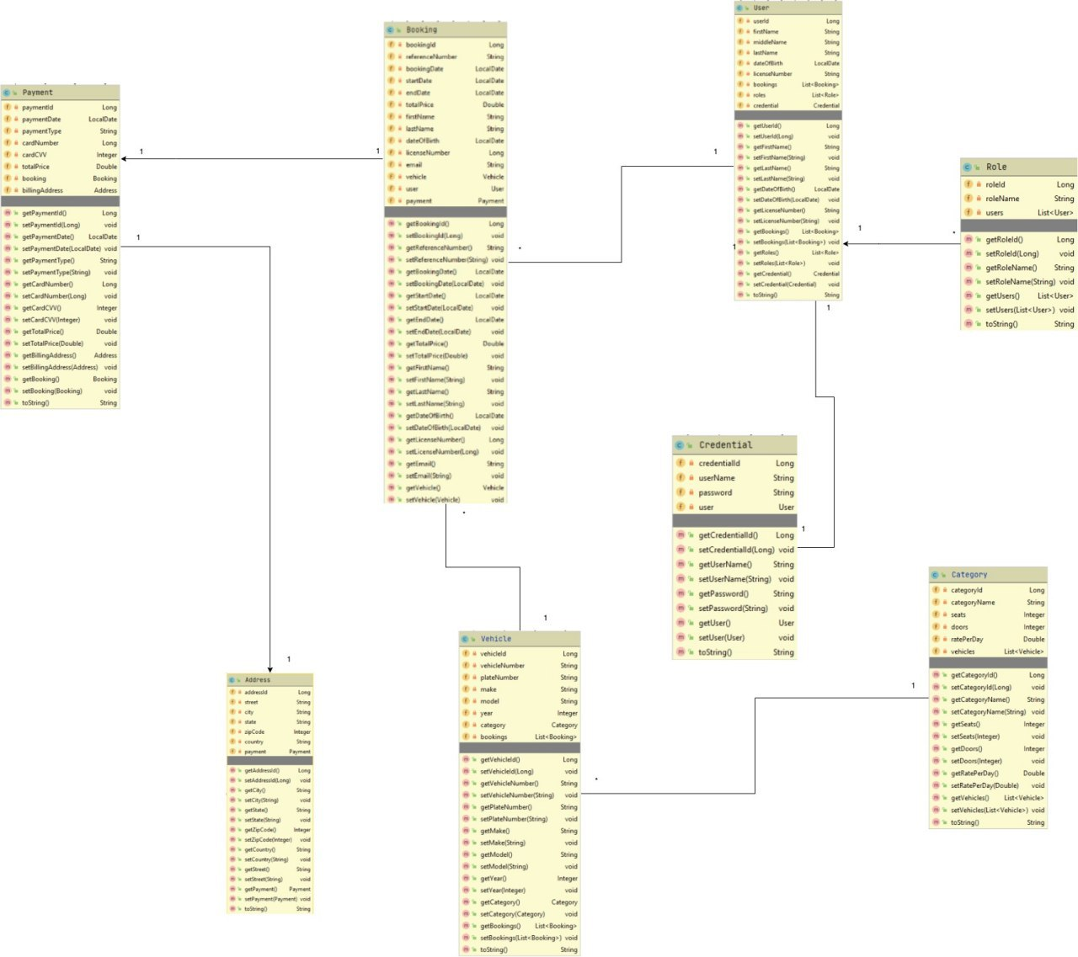
Static Model: Main Class Diagram

Slide 16


